Slide 1
Cornerstone City Church Peninsula Plus Community Hoo Are Ya
01-10-2023

Slide 2
Great Big God
CCLI Song # 3373437
Jo Hemming | Nigel Hemming
© 2001 Vineyard Songs (UK/Eire) (Admin. by Integrity Music Ltd)
For use solely with the SongSelect® Terms of Use. All rights reserved. www.ccli.com
CCLI Licence No. 33265

Slide 3
1/2
Our God is a great big God
Our God is a great big God
Our God is a great big God
And He holds us in His hands

Slide 4
2/2
He's higher than a skyscraper
And He's deeper than a submarine
He's wider than the universe
And beyond my wildest dreams
And He's known me and He's loved me
Since before the world began
How wonderful to be a part of
God's amazing plan

Slide 5
Hosanna (Praise Is Rising)
CCLI Song # 4662491
Brenton Brown | Paul Baloche
© 2005, 2006 Integrity's Hosanna! Music (Admin. by Integrity Music Ltd)
Thankyou Music (Admin. by Integrity Music Ltd)
For use solely with the SongSelect® Terms of Use. All rights reserved. www.ccli.com
CCLI Licence No. 33265

Slide 6
1/6
Praise is rising
Eyes are turning to You
We turn to You
Hope is stirring
Hearts are yearning for You
We long for You

Slide 7
2/6
‘Cause when we see You
We find strength to face the day
In Your presence
All our fears are washed away
(Washed away)

Slide 8
3/6
Hosanna Hosanna
You are the God who saves us
Worthy of all our praises
Hosanna Hosanna
Come have Your way among us
We welcome You here Lord Jesus

Slide 9
4/6
Hear the sound of
Hearts returning to You
We turn to You
In Your Kingdom
Broken lives are made new
You make us new

Slide 10
5/6
‘Cause when we see You
We find strength to face the day
In Your presence
All our fears are washed away
(Washed away)

Slide 11
6/6
Hosanna Hosanna
You are the God who saves us
Worthy of all our praises
Hosanna Hosanna
Come have Your way among us
We welcome You here Lord Jesus

Slide 12


Slide 13
This Is Amazing Grace
CCLI Song # 6333821
Jeremy Riddle | Josh Farro | Phil Wickham
© 2012 WC Music Corp. (Admin. by / Small Stone Media BV, Holland (Admin. in the UK/Eire by Song Solutions www.songsolutions.org))
Bethel Music Publishing (Admin. by Song Solutions)
Phil Wickham Music (Admin. by Song Solutions www.songsolutions.org)
Seems Like Music (Admin. by Song Solutions www.songsolutions.org)
Sing My Songs (Admin. by Song Solutions www.songsolutions.org)
For use solely with the SongSelect® Terms of Use. All rights reserved. www.ccli.com
CCLI Licence No. 33265

Slide 14
1/7
Who breaks the power of sin and darkness
Whose love is mighty and so much stronger
The King of Glory the King above all kings

Slide 15
2/7
Who shakes the whole earth with holy thunder
And leaves us breathless in awe and wonder
The King of Glory the King above all kings

Slide 16
3/7
This is amazing grace
This is unfailing love
That You would take my place
That You would bear my cross
You laid down Your life
That I would be set free
Oh Jesus I sing for all that You've done for me

Slide 17
4/7
Who brings our chaos back into order
Who makes the orphan a son and daughter
The King of Glory the King of Glory

Slide 18
5/7
Who rules the nations with truth and justice
Shines like the sun in all of its brilliance
The King of Glory the King above all kings

Slide 19
6/7
This is amazing grace
This is unfailing love
That You would take my place
That You would bear my cross
You laid down Your life
That I would be set free
Oh Jesus I sing for all that You've done for me

Slide 20
7/7
Worthy is the Lamb who was slain
Worthy is the King who conquered the grave
Worthy is the Lamb who was slain
Worthy is the King who conquered the grave
Worthy is the Lamb who was slain
Worthy is the King who conquered the grave
Worthy is the Lamb who was slain
Worthy worthy worthy

Slide 22
Build My Life
CCLI Song # 7070345
Brett Younker | Karl Martin | Kirby Kaple | Matt Redman | Pat Barrett
© 2016 Capitol CMG Genesis (Admin. by Capitol CMG Publishing)
Housefires Sounds (Admin. by Capitol CMG Publishing)
sixsteps Music (Admin. by Capitol CMG Publishing)
Vamos Publishing (Admin. by Capitol CMG Publishing)
worshiptogether.com songs (Admin. by Capitol CMG Publishing)
Said And Done Music (Admin. by Integrity Music Ltd)
Thankyou Music (Admin. by Integrity Music Ltd)
Martin, Karl Andrew (Admin. by Sentric Music)
Bethel Music Publishing (Admin. by Song Solutions)
Kaple Music (Admin. by Song Solutions)
For use solely with the SongSelect® Terms of Use. All rights reserved. www.ccli.com
CCLI Licence No. 33265

Slide 23
1/4
Worthy of ev'ry song we could ever sing
Worthy of all the praise we could ever bring
Worthy of ev'ry breath we could ever breathe
We live for You

Slide 24
2/4
Jesus the name above ev'ry other name
Jesus the only one who could ever save
Worthy of ev'ry breath we could ever breathe
We live for You
We live for You

Slide 25
3/4
Holy there is no one like You
There is none beside You
Open up my eyes in wonder and show me who You are
And fill me with Your heart
And lead me in Your love to those around me

Slide 26
4/4
I will build my life upon Your love
It is a firm foundation
I will put my trust in You alone
And I will not be shaken

Slide 27
Worthy Of it All
CCLI Song # 6280644
David Brymer | Ryan Hall
© 2012 Common Hymnal Publishing (Admin. by Integrity Music Ltd)
Innerland (Admin. by Integrity Music Ltd)
Underground Treasure (Admin. by Integrity Music Ltd)
Wayfinder Music (Admin. by Integrity Music Ltd)
For use solely with the SongSelect® Terms of Use. All rights reserved. www.ccli.com
CCLI Licence No. 33265

Slide 28
1/3
All the saints and angels
Bow before Your throne
All the elders cast their crowns
Before the Lamb of God and sing

Slide 29
2/3
You are worthy of it all
You are worthy of it all
For from You are all things
And to You are all things
You deserve the glory

Slide 30
3/3
Day and night,
Night and day,
Let incense arise
(X4)
Day and night
Night and day

Slide 31


Slide 32
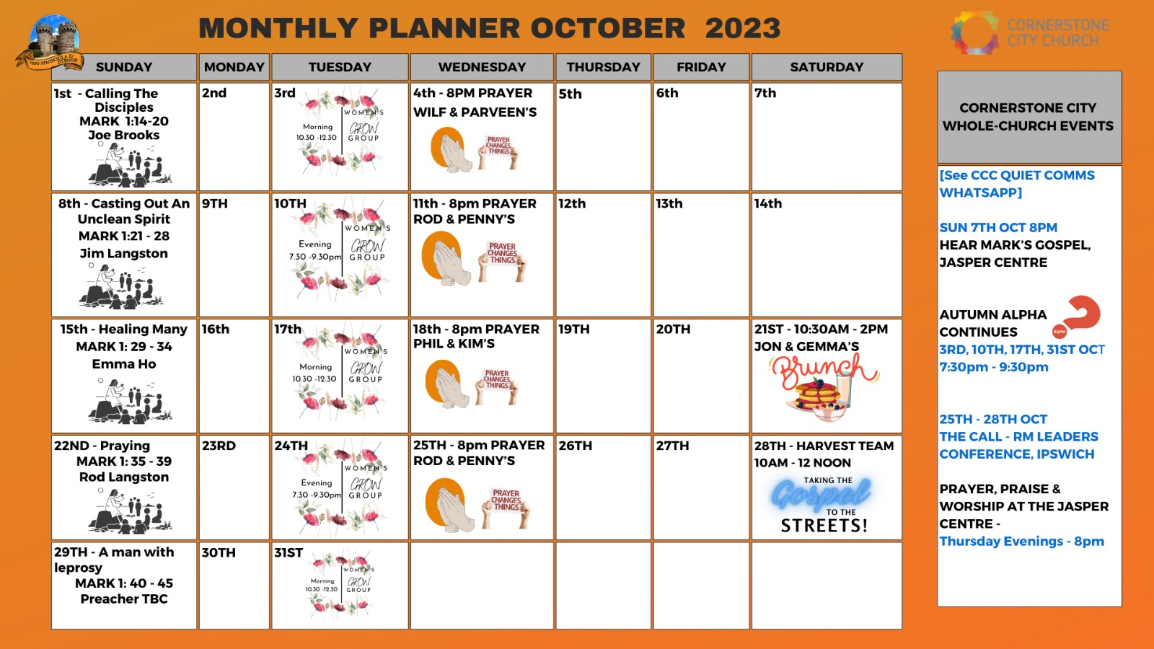

Slide 33


Slide 34
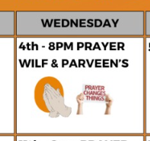

Slide 35


Slide 36


Slide 37


Slide 38


Slide 39


Slide 40
Christ is Enough
CCLI Song # 6514035
Jonas Myrin | Reuben Morgan
© 2012 Hillsong MP Songs; Hillsong Music Publishing Australia
For use solely with the SongSelect® Terms of Use. All rights reserved. www.ccli.com
CCLI License # 33265

Slide 41
1/4
Christ is my reward and all of my devotion
Now there's nothing in this world
That could ever satisfy
Through every trial my soul will sing
No turning back I've been set free

Slide 42
2/4
Christ is enough for me
Christ is enough for me
Everything I need is in You
Everything I need

Slide 43
3/4
Christ my all in all the joy of my salvation
And this hope will never fail
Heaven is our home
Through every storm my soul will sing
Jesus is here to God be the glory

Slide 44
4/4
I have decided to follow Jesus
No turning back no turning back The cross before me the world behind me
No turning back no turning back

Slide 45
2 Corinthians 14 May the grace of the Lord Jesus Christ, and the love of God, and the fellowship of the Holy Spirit be with you all

